Slide 1

Presented By
Kishan Dongare

Slide 2
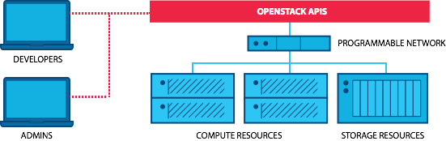
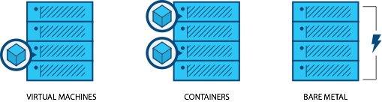
_{WHAT IT IS}
_{WHY USE IT}
_{THE COMMUNITY}
_{USING OPENSTACK}
_{FAQS}
What is OpenStack
OpenStack is open source and free software for building cloud Computing or it is a Cloud Operating System that is used to control the large pools of computing, storage, and networking resources within a data center and provisioned through OpenStack APIs with common authentication mechanisms.
It is programmable infrastructure as a service that allows users to have one platform for virtual machines, containers and bare metal. It helps to control a data center with the help of a web-based dashboard or command-line tools.
Notes:
OpenStack is open source software for building clouds. It is programmable infrastructure that allows users to have one platform for virtual machines, containers and bare metal. Hundreds of companies and tens of thousands of individuals from around the world have come together to create and support OpenStack because they believe in the importance of a standardized, ubiquitous cloud platform. OpenStack has multiple projects under its name. The projects cover foundational elements like compute, networking and storage, but also span from telemetry to orchestration to container APIs. You likely know an OpenStack user or vendor without even realizing it; half of the US Fortune 100 use OpenStack.

Slide 3
_{WHAT IT IS}
_{WHY USE IT}
_{THE COMMUNITY}
_{USING OPENSTACK}
_{FAQS}
OpenStack is open source
OPENSTACK PRINCIPLES
OPEN SOURCE
OPEN DESIGN
1
2
OpenStack infrastructure designs which are open to the public, include users, developers, community.
OpenStack is designed to be as publicly accessible anyone can see, modify, and distribute.
OPEN DEVELOPMENT
OPEN COMMUNITY
3
4
open community refers to the opportunity for anyone to join and contribute to the collaborative effort.
In OpenStack project anyone can contribute and access.
Notes:
OpenStack is one of the world’s largest open source projects. That means that it was created by people who contributed their time and talent to the project, and that no one “owns” OpenStack. OpenStack is able to constantly evolve and constantly improve because of its open source nature, and when needs arise or situations change, the community can quickly respond with innovative solutions. OpenStack is licensed under the Apache 2.0 license, which means that it is free to use, free to distribute and that others can modify OpenStack for their own needs. This creates a rich suite of options that all operate on the same underlying infrastructure. For users, this means you can switch between vendors or combine services without fear of being locked into a single, proprietary solution.

Slide 4
_{WHAT IT IS}
_{WHY USE IT}
_{THE COMMUNITY}
_{USING OPENSTACK}
_{FAQS}
OpenStack Cloud Models
There is a global shift towards cloud. The benefits: Agility, Scalability, Decreased Hardware Costs. OpenStack began in 2010 as a joint project of Rackspace Hosting and NASA.
Public cloud: In a public cloud, you share the same hardware, storage and network devices with other organizations. it is shared resource, “pay-as-you-go” models are common.
Private Cloud: Private cloud dedicated to a single users and can be hosted private cloud in a vendor’s data center or remotely managed private cloud.
Hybrid cloud: Hybrid Cloud is a mix of private cloud and public cloud orchestrated together to meet company needs.
3 CLOUD MODELS
Notes:
Before we jump into OpenStack, I wanted to set the stage by covering the current cloud models in the landscape. Public cloud is a shared resource operated by a third party, where you pay for what you’re using at what times, with typically a base cost for being on the service. Private cloud is a cloud dedicated to a single user, and historically this meant that the user was also responsible for running it in their data center, but we’ve been seeing “private-cloud-as-a-service” increasingly in the market over the last year. Hybrid cloud is a mix of public and private cloud orchestrated together. This is different from “multi cloud,” although you might hear them used interchangeably by mistake. “Multi-cloud” is when an organization uses multiple clouds from different vendors, for example, “Amazon Web Services and OpenStack,” “Azure and AWS,” ”Azure and OpenStack.”
To understand why all these companies are using OpenStack, we have to understand the recent advances and developments in operations and the move to the cloud. The OpenStack story is part of the larger global shift towards cloud systems. Companies of all sizes are realizing that the speed, sheer volume and desired-flexibility of today’s environment might not mesh with their legacy system or might leave some of their needs unmet. Cloud solutions can lower hardware costs, increase agility and allow companies to spin up or down resources as needed.

Slide 5
_{WHAT IT IS}
_{WHY USE IT}
_{THE COMMUNITY}
_{USING OPENSTACK}
_{FAQS}
What runs on OpenStack?
_{TELECOM/NFV}
_{High Performance Computing}
_{ENTERPRISE APPS}
_{BIG DATA}
86% of telecoms say OpenStack is important to their business; many are using OpenStack to virtualize their networks and implement edge computing to achieve agility significant cost savings.
CERN runs one of the largest OpenStack clouds to process data from the Large Hadron Collider, giving physicists the resources they need to unleash the secrets of the universe.
Comcast powers customer-facing and internal applications and services for both production and development environments with OpenStack.
Banco Santander runs 1,000 compute nodes of OpenStack in data centers across the world, and uses Cloudera on OpenStack to power fraud detection.
_{MULTI-CLOUD}
_{E-COMMERCE}
_{DEVELOPER PRODUCTIVITY}
_{WEB SERVICES}
DigitalFilm Tree uses interoperable OpenStack private and public clouds to process thousands of hours of raw footage into a one-hour TV show.
Walmart moved their global e-commerce platform to OpenStack, powering desktop, mobile, tablet and kiosk users.
Adobe Digital Marketing uses OpenStack to convert their existing virtualization environment into self-service IT.
Workday moved their on-demand software services from static, virtualized environments to a fully elastic and scalable platform based on OpenStack.
Notes:
At openstack.org/user-stories you can read user stories and see more examples like these short blurbs.

Slide 6
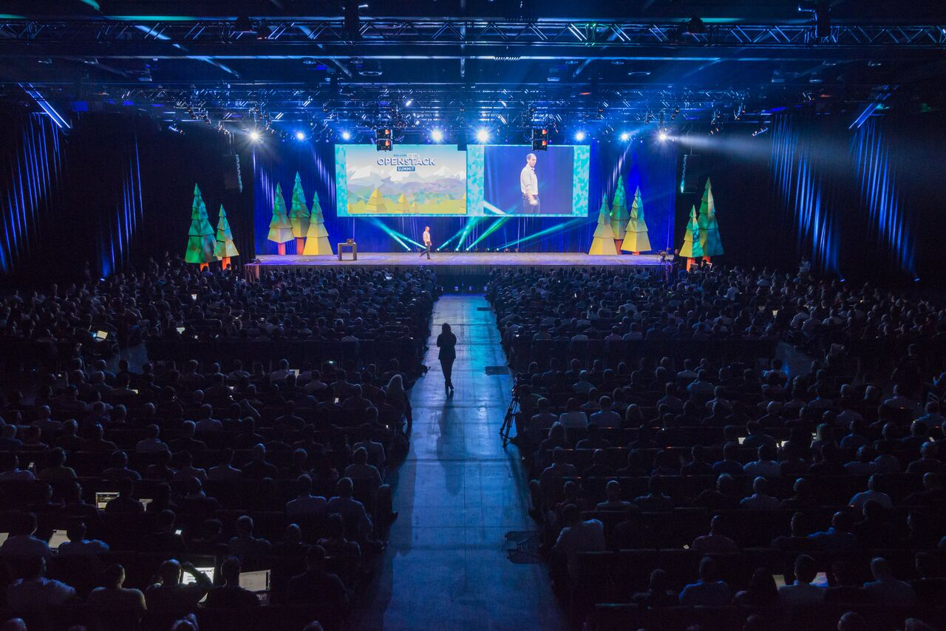

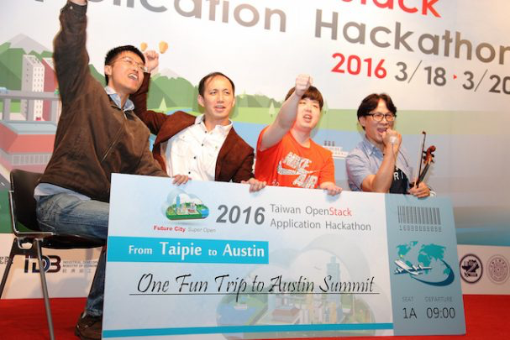
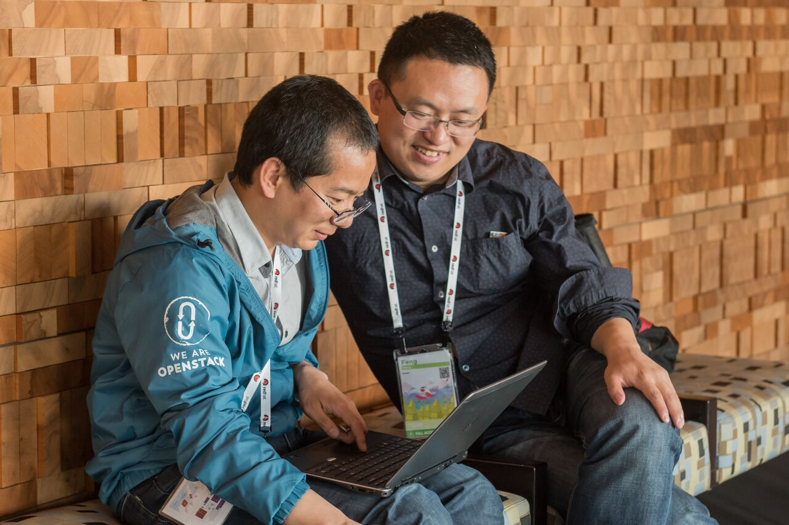
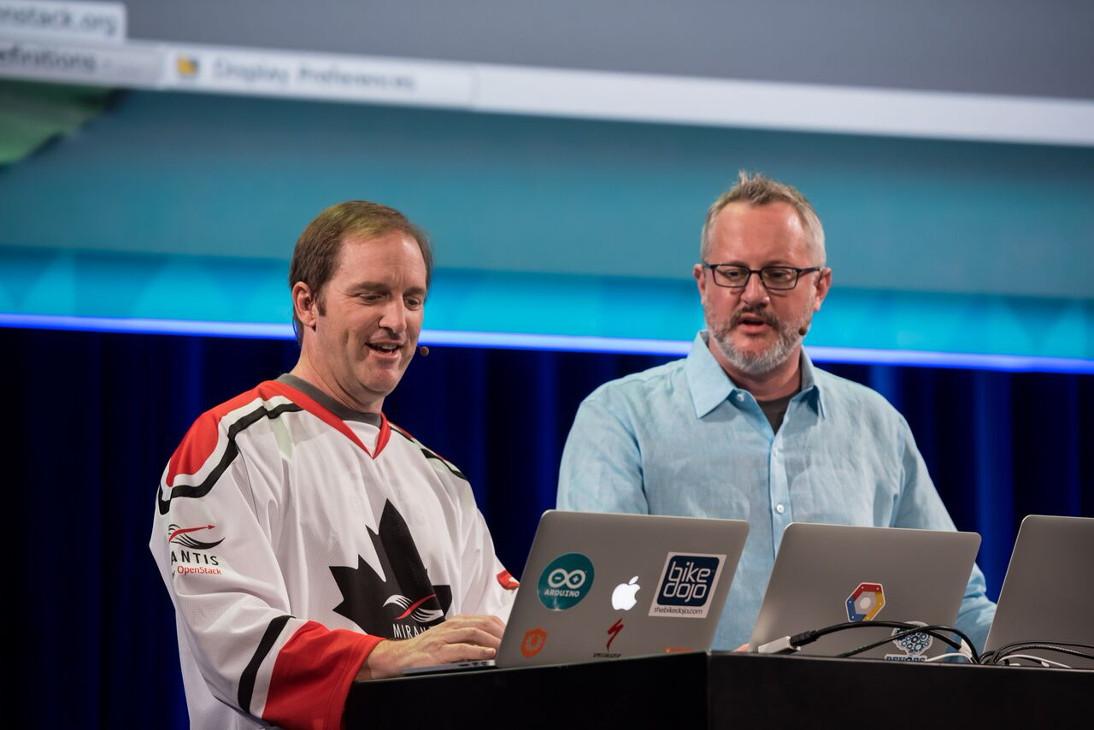
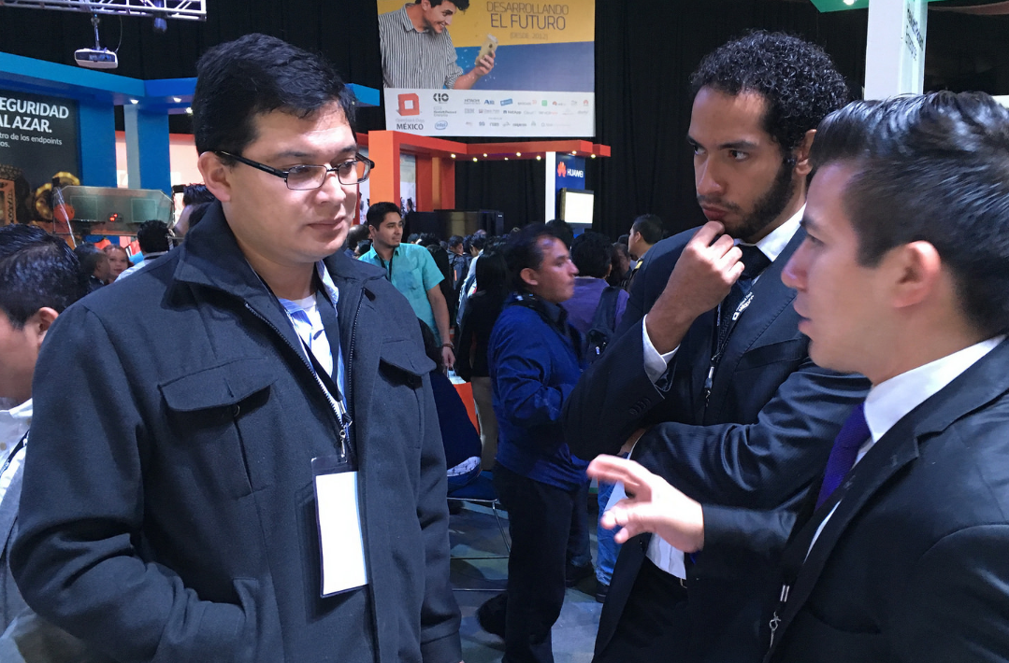
_{WHAT IT IS}
_{WHY USE IT}
_{THE COMMUNITY}
_{USING OPENSTACK}
_{FAQS}
How does the community collaborate?
_{GLOBAL OPENSTACK SUMMITS}
_{VOTING ON REPRESENTATIVES}
_{HACKATHONS}
_{TOPICAL MAILING LISTS}
CONTRIBUTING CODE, DEVELOPER PLANNING SESSIONS
REGIONAL OPENSTACK DAYS & LOCAL MEETUPS
Notes:
You can find the OpenStack community at the twice-annual global Summits; at local OpenStack Days, Hackathons and Meetups; participating on a wide variety of mailing lists; contributing code and participating in the design process; and voting on community representatives. You can learn more and sign up yourself at
openstack.org/join.

Slide 7
_{WHAT IT IS}
_{WHY USE IT}
_{THE COMMUNITY}
_{USING OPENSTACK}
_{FAQS}
Next Steps
How you can get started in OpenStack…
1
JOIN THE FOUNDATION: OPENSTACK.ORG/JOIN
2
LEARN HOW TO CONTRIBUTE: OPENSTACK.ORG/COMMUNITY
3
READ THIS: DESIGNING, MIGRATING AND DEPLOYING APPLICATIONS
4
ATTEND AN EVENT IN YOUR AREA: OPENSTACK.ORG/EVENTS
5
MORE RESOURCES: OPENSTACK.ORG/SOFTWARE/START/

Slide 8
Thank You

